Slide 1

INTRUSION DETECTION IN WIRELESS NETWORKS
S.NO | Name | USN
1. | Sparsh Gupta | 1MS12CS110
2. | Hena | 1MS12CS038
3. | Sunayana Bhowmik | 1MS12CS117
4. | Sumeet Sen | 1MS12CS116

Slide 2

INDEX
Network Security
Intrusion Detection
Intrusion Breakdown
Intrusion Detection Models
Security in Wireless Networks
Wireless Attacks Classification
Access Control attacks
Confidentiality attacks
Integrity attacks
Authentication attacks
Availability attacks
AI in Intrusion Detection
AI techniques
Expert System
Pattern Matching
Genetic Algorithm in IDS
Conclusion

Slide 3

NETWORK SECURITY
Network security consists of the policies adopted to prevent and monitor unauthorized access, misuse, modification, or denial of a compute network and network-accessible resources.
Network security starts with authenticating, commonly with a username and a password. Since this requires just one detail authenticating the user name —i.e., the password— this is sometimes termed one-factor authentication.

Slide 4

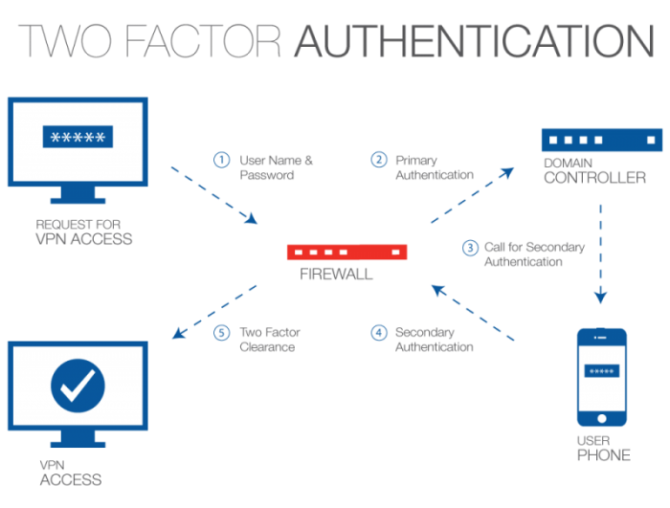
NETWORK SECURITY

Slide 5

NETWORK SECURITY
Once authenticated, a firewall enforces access policies such as what services are allowed to be accessed by the network users.
Communication between two hosts using a network may be encrypted to maintain privacy.
Honeypots, essentially decoy network-accessible resources, may be deployed in a network as surveillance and early-warning tools, as the honeypots are not normally accessed for legitimate purposes.

Slide 6


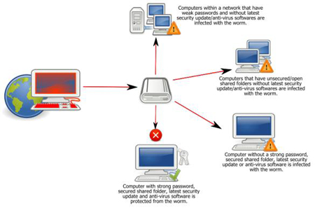
INTRUSION DETECTION
Intrusion detection is the process of discovering, analyzing, and reporting unauthorized or damaging network or computer activities
Intrusion detection discovers violations of confidentiality, integrity, and availability of information and resources

Slide 7

IMPORTANCE OF INTRUSION DETECTION
Provide digital forensic data to support post-compromise law enforcement actions
Identify host and network misconfigurations
Improve management and customer understanding of the Internet's inherent hostility
Learn how hosts and networks operate at the operating system and protocol levels

Slide 8

INTRUSION BREAKDOWN
Intrusion begins when intruder takes steps to fulfill objectives
A flaw or weakness must be exploited, either by hand or with a tool
Flaws include social engineering: human processes can weaken security/integrity
Intrusion ends when attacker succeeds or gives up
Attacks can have multiple victims or attackers

Slide 9

Intrusion detection models
Two primary intrusion detection models
Network-based intrusion detection monitors network traffic for signs of misuse
Host-based intrusion detection monitors computer processes for signs of misuse
So-called "hybrid" systems may do both
A hybrid IDS on a host may examine network traffic to or from the host, as well as processes on that host

Slide 10

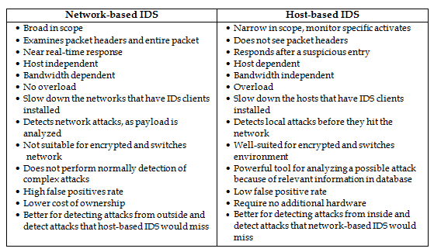
IDS CLASSIFICATION

Slide 11

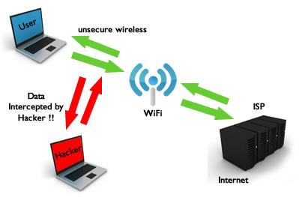
SECURITY IN WIRELESS NETWORKS
Wireless security is the prevention of unauthorized access or damage to computers using wireless networks. The most common types of wireless security are Wired Equivalent Privacy (WEP) and Wi-Fi Protected Access (WPA).
A Wireless Intrusion Prevention System (WIPS) is a concept for the most robust way to counteract wireless security risks.

Slide 12

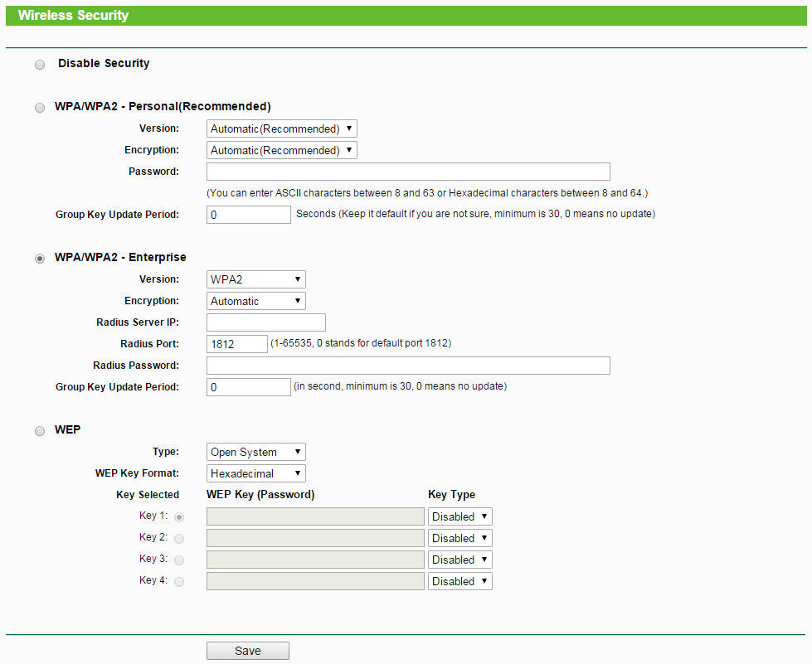
INTERFACE OF WIRELESS SECURITY ON A ROUTER

Slide 13

SECURITY CATEGORIES
All computer activity and network traffic falls in one of three categories:
Normal
Abnormal but not malicious
Malicious
Properly classifying these events are the single most difficult problem

Slide 14

WIRELESS ATTACKS CLASSIFICATION
Access control attacks These attacks attempt to penetrate a network by using wireless or evading WLAN access control measures, like AP MAC filters and 802.1X port access controls.
Confidentiality attacks These attacks attempt to intercept private information sent over wireless associations, whether sent in the clear or encrypted by 802.11 or higher layer protocols.
Integrity attacks These attacks send forged control, management or data frames over wireless to mislead the recipient or facilitate another type of attack (e.g., DoS).
Authentication attacks Intruders use these attacks to steal legitimate user identities and credentials to access otherwise private networks and services.
Availability attacks These attacks impede delivery of wireless services to legitimate users, either by denying them access to WLAN resources or by crippling those resources.

Slide 15

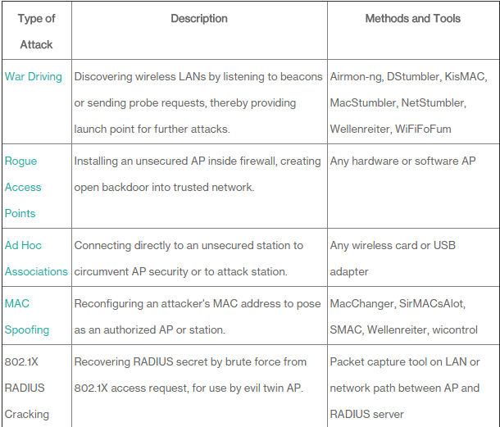
ACCESS CONTROL ATTACKS

Slide 16

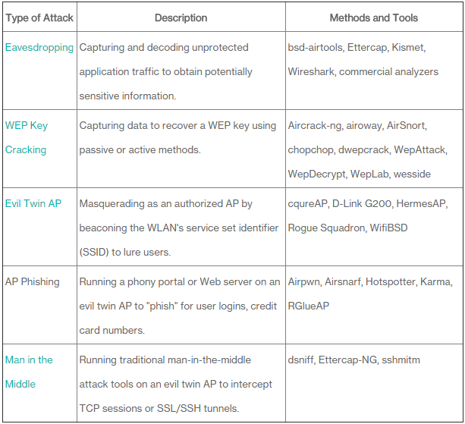
CONFIDENTIALITY ATTACKS

Slide 17

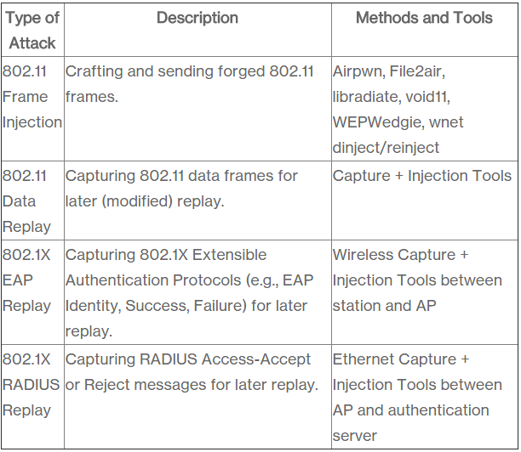
INTEGRITY ATTACKS

Slide 18

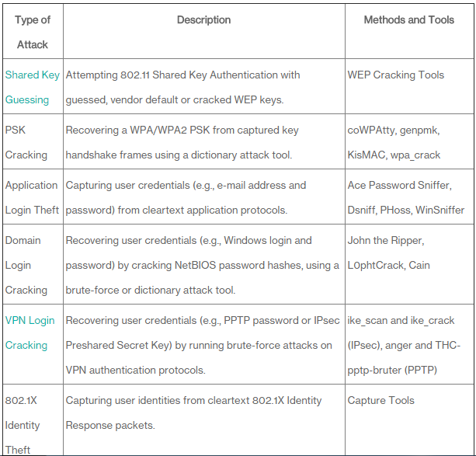
AUTHENTICATION ATTACKS

Slide 19

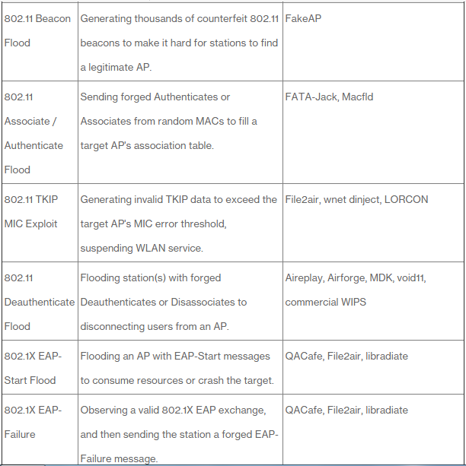
AVAILABILITY ATTACKS

Slide 20

ARTIFICIAL INTELLIGENCE IN INTRUSION DETECTION
Intrusion detection systems focus on discovering abnormal system events in computer networks and distributed communication systems
Uncertainty nature of intrusions => Fuzzy Set
Different levels of security needs => Dynamic fuzzy boundary

Slide 21

Artificial intelligence techniques
For a intrusion detection system:
An expert system can be used to store a set of rules designed to detect the known intrusion activities
Pattern matching
Known intrusion signatures are encoded as patterns
Then matched against the audit data introduced by the analysis component

Slide 22

Genetic Algorithm IN IDS
Genetic algorithms can be used to evolve simple rules for network traffic. The rules stored in the rule base are usually in the following form
if { condition } then { act }
Eg.
if {the connection has following information:
source IP address 124.12.5.18;
destination IP address:130.18.206.55;
destination port number: 21;
connection time: 10.1 seconds }
then {stop the connection}

Slide 23
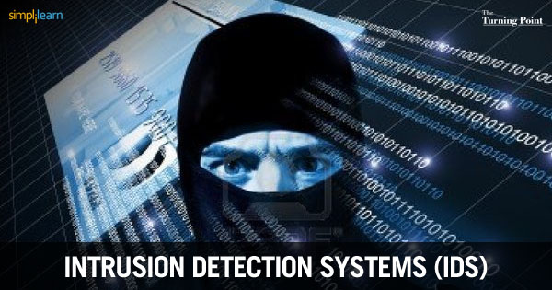
CONCLUSION
Protect
- Encryption
- Firewalls
- Authentication
- Biometrics
- AI Based algorithms
Detect
- Intrusions
- Attacks
- Misuse of Resources
- Data Correlation
- Data Visualization
- Malicious Behaviors
- Network Status/ Topology
React
- Response
- Terminate Connections
- Block IP Addresses
- Containment
- Recovery
- Reconstitute

Slide 24
THANK YOU

